Slide 1


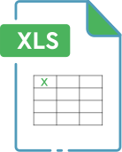

UBER SUPPLY DEMAND GAP
Analyzed Uber ride request data to uncover demand supply gaps and peak hour inefficiencies.
Used Excel, SQL, and Python for data cleaning, visualization, and insight generation to support operational improvements.
Presented by
Karthik Doguparthi

Slide 2
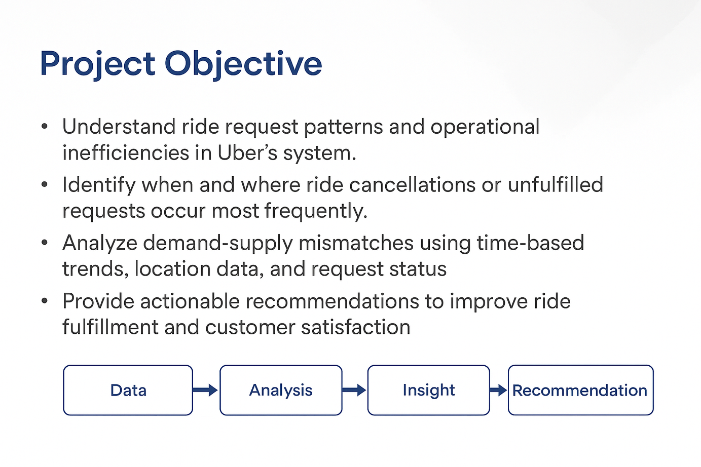
Project Objective
To understand ride request patterns and operations in the Uber ride system.
Identify the demand supply relationship at the pickup location.
Analyse the most travelled time of the day for accuracy.
Recommendations to improve the customer satisfaction.

Slide 3
About the Dataset
The dataset contains 6,745 ride requests provided by Uber.
Includes columns like request ID, timestamps, pickup point, driver ID, status, and distance.
Covers various ride outcomes such as Trip Completed, Cancelled, and No Cars Available.
The original file was cleaned in Excel, handling with missing values.
Created new columns like Day category, Travel time for analysis and insights.

Slide 4
Data cleaning
Performed data cleaning using Excel.
Changed the mixed date type in columns to short date type.
Split request timestamp and drop timestamp columns to date and time using a delimiter.
Created a column to find the category of day when pickup is requested.
New calculated column travel time is created to find how long are the rides requested for.
New calculated column is derived from travel time to show the kind of distance (Near/Far).

Slide 5
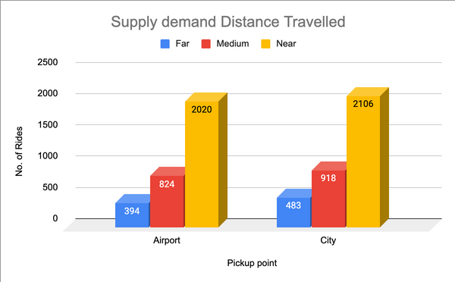
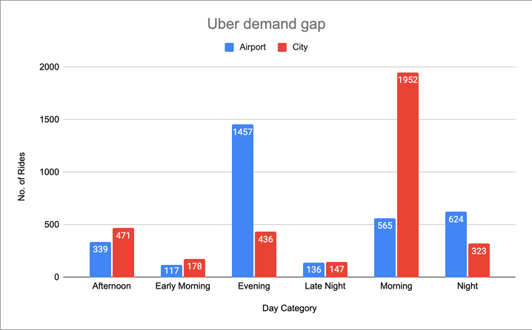
Dashboards
Fig 1 shows the count of types of distance travelled.
Fig 2 shows count of bookings per the time of day.
Fig 1
Fig 2

Slide 6
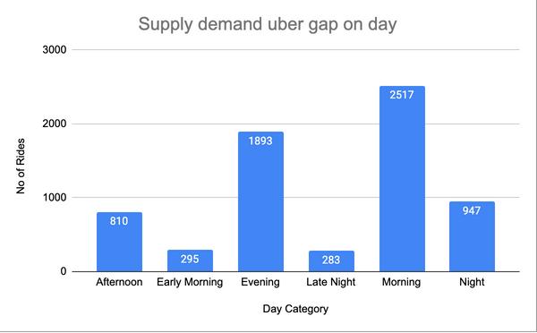
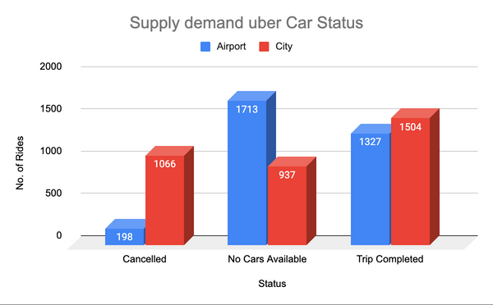
Dashboards
Fig 3 shows count of total bookings per the type of day.
Fig 4 shows count of booking status from pickup location.
Fig 3
Fig 4

Slide 7
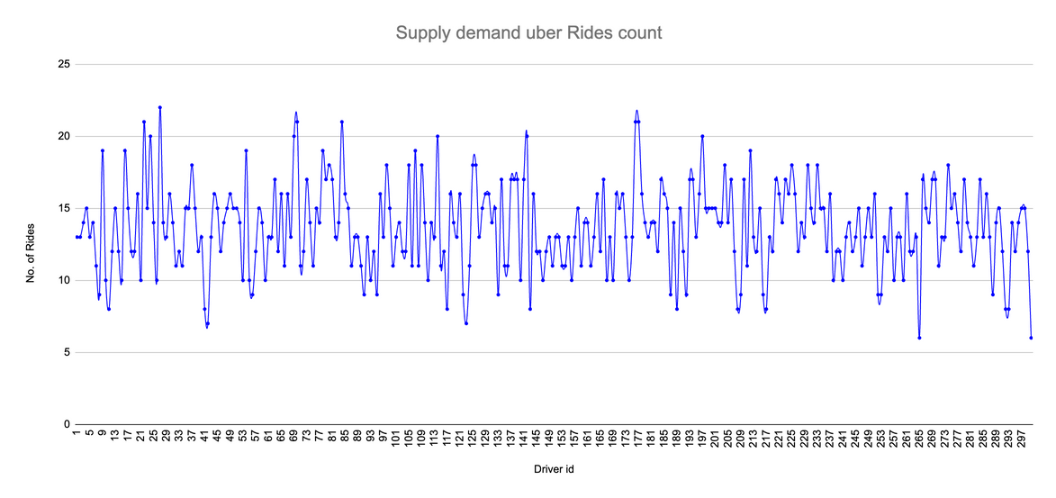
Dashboards
Fig 5 shows the total no. of rides by the drivers assigned with the driver id.
Fig 5

Slide 8
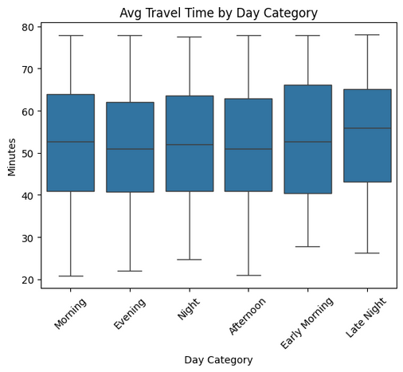
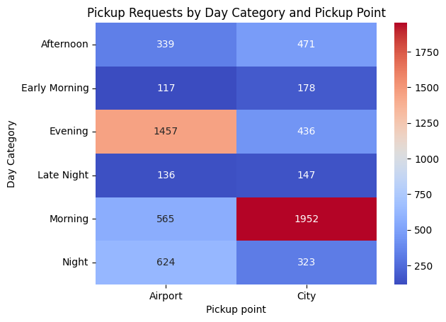
Exploratory Data Analysis in Colab
Fig 6 shows average travel time segregated by day category.
Fig 7 shows correlation chart with count of requests from pickup.
Fig 4
Fig 6
Fig 7

Slide 9
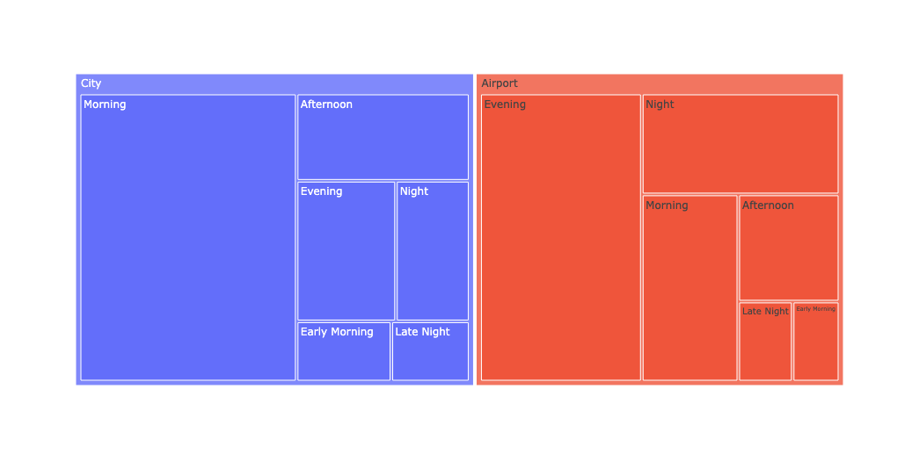
Exploratory Data Analysis in Colab
Fig 8 shows the treemap of the relationship between the bookings from pickup location wrt each other.
Fig 8

Slide 10
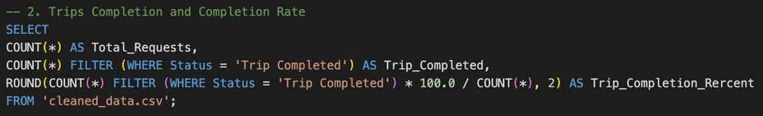

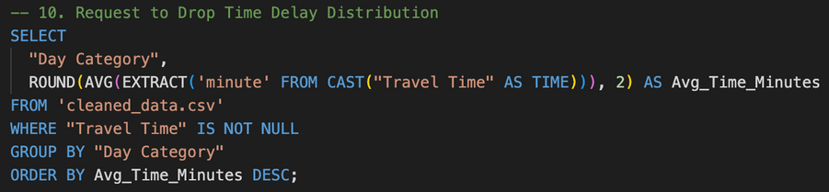
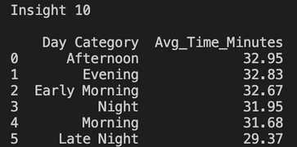
SQL Insights
Fig 9 and 10 gives insight about the Trips completed and Trip completion percentage.
Fig 9
Fig 10
Fig 11 and 12 gives insight about the average travel time wrt categories of the day.
Fig 11
Fig 12

Slide 11
Solution
Deploying more drivers at airport can reduce trip cancellation and increase the availability of cars.
Provide coupons for clients who travel more often and median of travel time.
Give incentive for drivers who are working during the peak hours.
Implement cancellation charges(during peak hours) to reduce the number of cancellations.
Providing incentive for night rides can likely increase number of drivers.

Slide 12
Conclusion
The goal was to understand Uber ride pattern using real time data.
Cleaned and transformed data using Excel.
Performed EDA in Colab.
Found insights using SQL via VS Code.
Built pivot tables, dashboards in Excel and visualizations in Colab.
Delivered key solutions which will help Uber to increase business.

